Slide 1

Exercises
Let us practice the concepts learned by solving some problems.

Slide 2
Problem Statement
  Draw a flowchart and write the pseudocode to print the product of the first 10 even numbers.
  Allocated time to solve the problem is 20 minutes.
Notes:
Explain the meaning of pseudocode. Using the example of adding two numbers explain how easily an pseudocode can be rewritten to program using a specific programming language.

Slide 3
Problem Statement (Contd.)
Answer the following questions:
  How many variables are required in the given problem?
  What type of variables you will declare?
  What is the expected output?
Notes:
Explain the concept of dry run. Tell that it will help to know the output of a program by taking sample values.

Slide 4


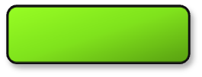



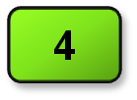
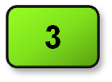
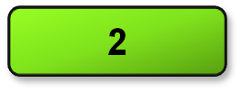
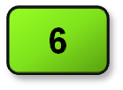

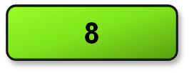

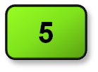

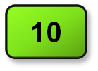

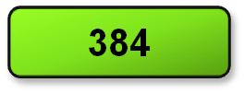
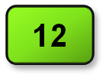

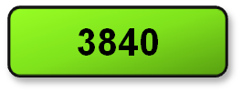
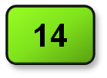
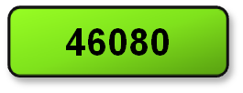
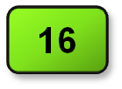
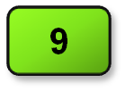
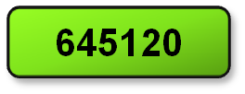
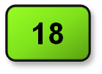

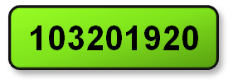
Solution
Start
Let us see the dry run of the flowchart.
nNum
nEven
nProd
numeric nNum, nProd, nEven
nNum = 2, nProd = 1, nEven = 2
nProd = nNum * nProd
nNum = nNum + 2
nEven = nEven + 1
Yes
Is nEven < 10 ?
No
Display nProd
Stop
Notes:
Explain the meaning of pseudocode. Using the example of adding two numbers explain how easily an pseudocode can be rewritten to program using a specific programming language.

Slide 5
Solution (Contd.)
Let us now see the pseudocode for the flowchart.
  begin
  numeric nNum, nProd, nEven
  nNum = 2, nEven = 0, nProd = 1
  while (nEven < 10)
  begin
  nProd = nNum * nProd
  nNum = nNum + 2
  nEven = nEven + 1
  end
  display nProd
  end
Notes:
Explain the meaning of pseudocode. Using the example of adding two numbers explain how easily an pseudocode can be rewritten to program using a specific programming language.

